Slide 1

Let’s Breathe

Slide 2

Objectives
To observe “How aware am I of my breathing?”
To increase our O2 Level in our body
Understanding about what’s reflected through the breath
Notes:
So, let’s we open our camera

Slide 3
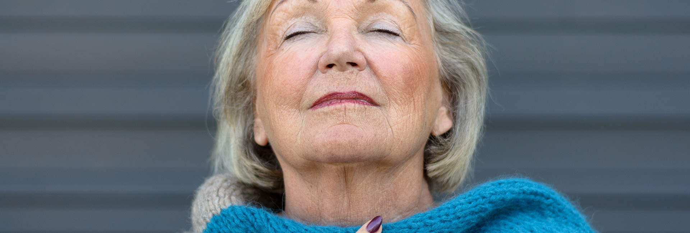

“When you own your breath,
Nobody can steal your peace”
~ Unknown

Slide 4



How aware am I of my breathing?
#1
3
2
1
5
6
4
9
8
7

Slide 5
How to increase my O2 level?
#2
Notes:
What laughing memory did I have?

Slide 6

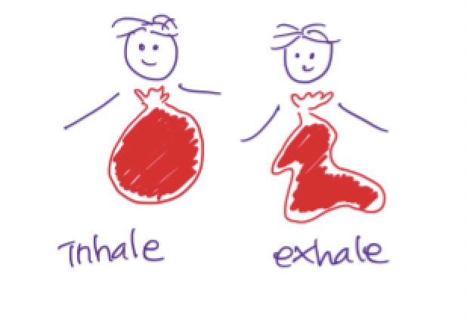

How to increase my O2 level?
#2
Light
Slow
Deep
Notes:
What laughing memory did I have?

Slide 7
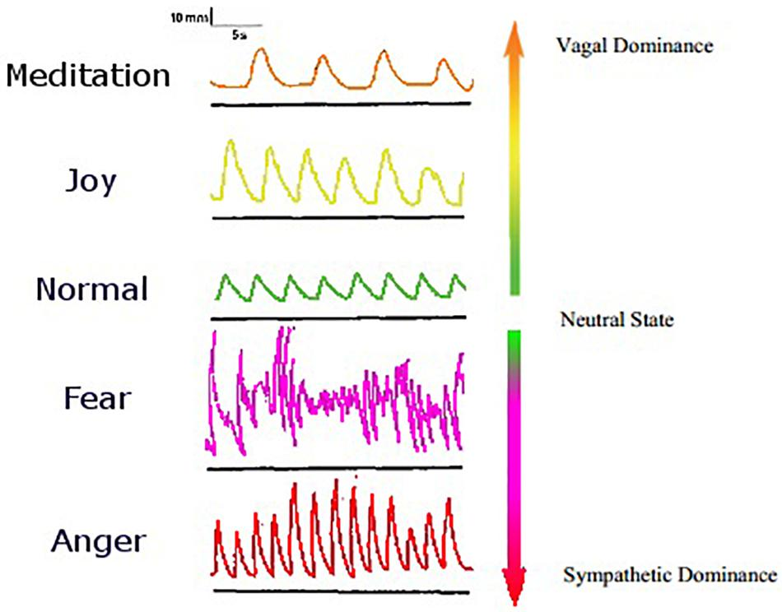

Slide 8
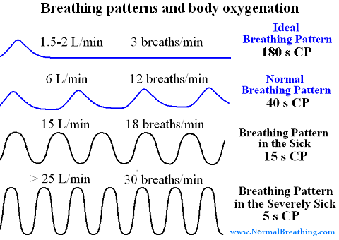

Slide 9
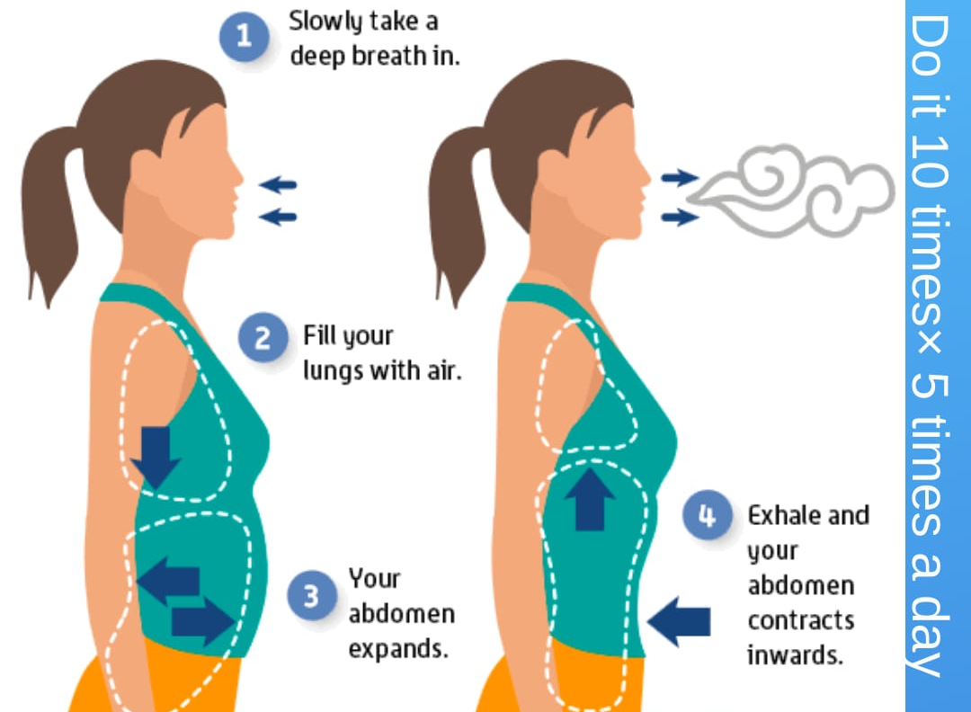

Slide 10
How does my breath represent me?
#3
1
4

Slide 11
How aware am I of
my breathing?
3
2
How to increase
my O2 level?
1
5
6
4
How does my breath
represent me?
9
8
7

Slide 12
